Slide 1

Job Posting Analysis for a Recruiting Firm

Slide 2

Company Profile
Company Name – Triedge Solution Pvt. Ltd.
Founded in 2012, based in New Delhi, India.
It operates as a recruitment service provider.
Serves individuals, start-ups, and enterprises.
Known for providing quality employee without any sourcing fee.
Mission:
Empower ambitious professionals and organizations by providing innovative and effective career platforms, talent acquisition, training, and HR services, aiming to bridge skill gaps and foster growth.

Slide 3

Services
Skill Development / Training
Resume Edge: Bespoke resume construction and improvement.
Interview SkillUp
Corporate Training
Workshops & Webinars
Career Solutions
InternEdge: Using this site students and graduates can find internships.
Campus Jobs
Career Coaching
Recruitment Services:
Manpower and staffing solutions of various industries such as IT, healthcare, manufacturing, retail and real estate.
Knowledge & Networking
Readers Galleria & Triedge Mantra: Centers of information where readers get insights, articles and career guidelines.

Slide 4
Data Sourcing And Research Analysis
Role:
To measure trends in a job market Identify demand trends in various roles, skill set and geographical location.
This project aims to Data sourcing from job portals like Naukri, Internshala and LinkedIn.
Extract, Transform and Load data into a master table.
To Clean, categorize, and organize raw job posting data to make it structured, and easy to analyze.

Slide 5
FLOW CHART OF THE PROJECT
Identify Job Portals
Design Data Template
Collect Collection
Dashboard Generation
Data Analysis
Data Cleaning

Slide 6
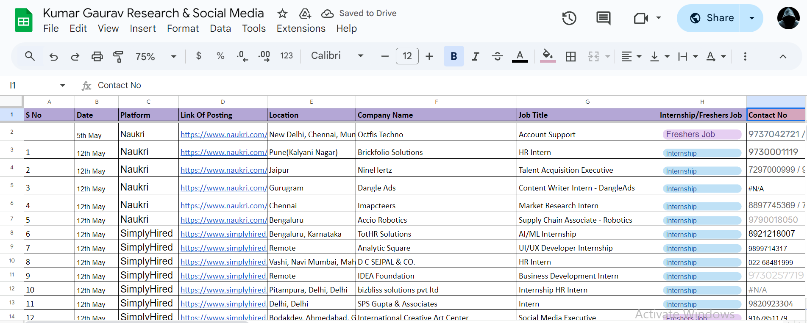
Data Template
Date , Job portal Name, Latest Posting Link
Location, Company
Job Title, Job Type,
Contact details of recruiter(like Contact No., Email id, Linkedin)
Recruiter details
Founder’s or CEO details
Social Media Pages of the company

Slide 7
Data Collection
Data was collected mainly by top job sites like naukri.com, LinkedIn and Internshala that are considered well known websites of employment and career information. The postings were read in-depth and the data was recorded using the prepared data template.
Data quality was ensured through the verification of the data entires that were cross-checked to ascertain data correctness and multiple listings were removed.
Data Analysis
The most frequent job occupations and destinations were identified with the help of the frequency distributions.
Trend analysis was carried out to determine the urge of freshers relative to intern at various platforms.

Slide 8
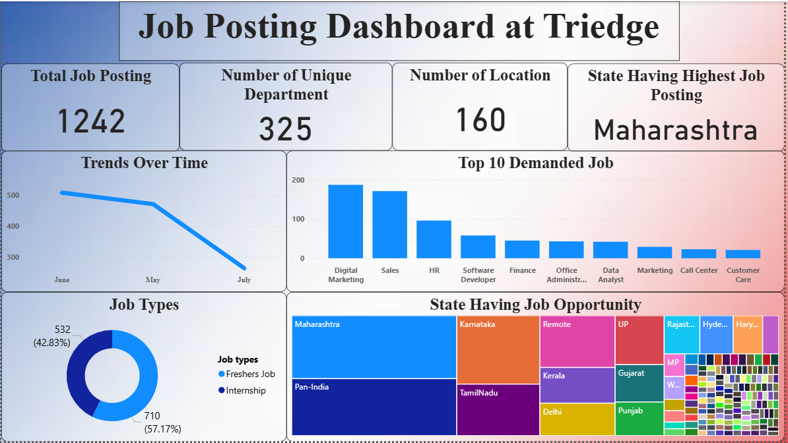

Slide 9
Findings And Insight
KPIs
Total postings: 1242 have been recorded in the data set.
Uniquely Separated Departments Recruiting: The involvement of 325 departments clearly demonstrates the rationale of recruitments being taken up by a lot of diversity.
Uniqueness of Locations: 160 various locations where there are jobs available.
Top State by Number of Job Postings: Maharashtra is the top.

Slide 10
Findings And Insight
The trend of job postings is going in downward direction between June and July.
Most wanted functions remain digital (Marketing, Data Analyst) and the traditional functions Sales, HR.
This hiring is focused on the entry-level indicating that Triedge is targeting the young talent pools.
The employment is mostly concentrated in Maharashtra, Karnataka, Tamil Nadu, Delhi, and Pan-India meaning that these are the main centers of jobs.

Slide 11
Recommendation
Increase the focus on Digital and Sales Roles.
They can track recruiter activity and initiate a hiring drive or a hiring incentive every month to have consistent posting.
Having 57 percent of the assignments belonging to freshers.
Some good markets are Maharashtra, Karnataka and Pan India company should explore into tier-2 and tier-3 cities in which the competition is not so intense but the demand is on the rise.

Slide 12
THANK YOU

